Slide 1
Objective
To introduce models of diode
To introduce the concept and function of diode
To be able to distinguish the usage of diodes in different applications

Slide 2
Contents
  Diode DC Load Line
  The effect of R_{L} and V_{S} on DC load line
  The effect of AC on diode load line
    Analysis of diode circuit
  Half-Wave Rectifier
  Full-Wave Rectifier (transformer coupled)
  Full-Wave Rectifier (bridge)
  Clipper
  Clamper

Slide 3
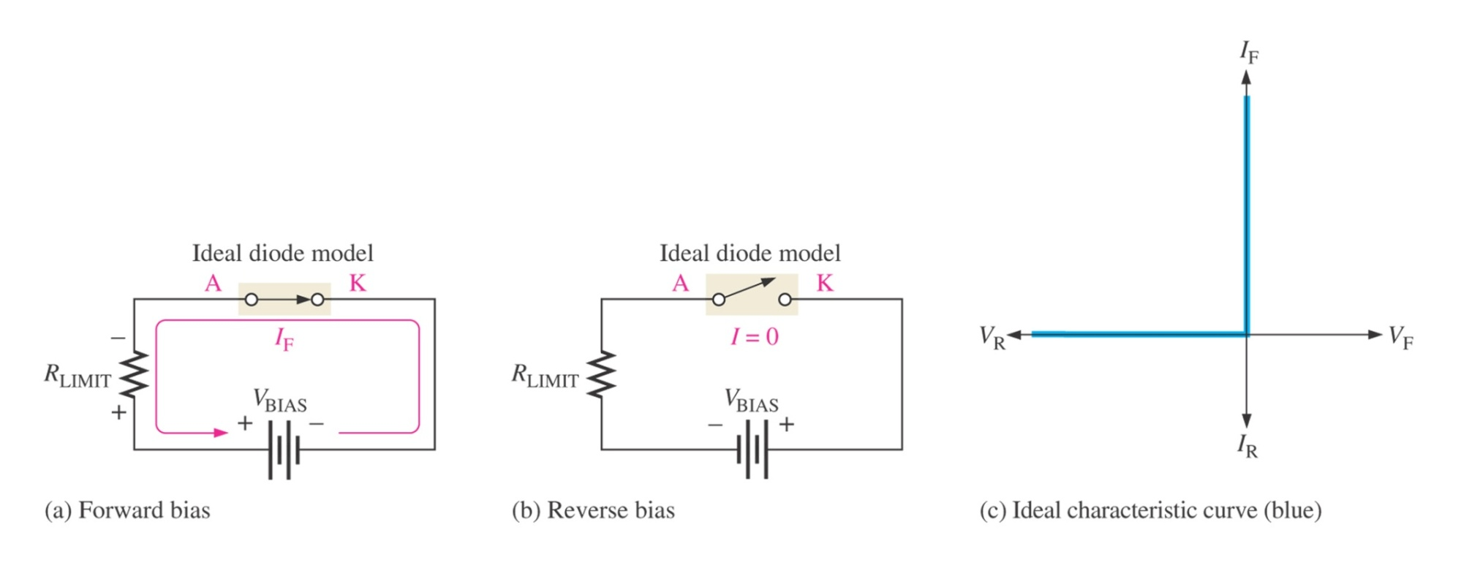
The ideal model of a diode.

Slide 4
Diode Circuit Models
The Ideal Diode Model
The diode is designed to allow current to flow in only one direction. The perfect diode would be a perfect conductor in one direction (forward bias) and a perfect insulator in the other direction (reverse bias). In many situations, using the ideal diode approximation is acceptable.
Example: Assume the diode in the circuit below is ideal. Determine the value of I_{D} if a) V_{A} = 5 volts (forward bias) and b) V_{A} = -5 volts (reverse bias)
R_{S} = 50 Ω
a) With V_{A} > 0 the diode is in forward bias and is acting like a perfect conductor so:
I_{D} = V_{A}/R_{S} = 5 V / 50 Ω = 100 mA
b) With V_{A} < 0 the diode is in reverse bias and is acting like a perfect insulator, therefore no current can flow and I_{D} = 0.
I_{D}
+
V_{A}
_

Slide 5
Diode Circuit Models
The Ideal Diode with Barrier Potential
This model is more accurate than the simple ideal diode model because it includes the approximate barrier potential voltage. Remember the barrier potential voltage is the voltage at which appreciable current starts to flow.
+
V_{φ}
Example: To be more accurate than just using the ideal diode model include the barrier potential. Assume V_{φ} = 0.3 volts (typical for a germanium diode) Determine the value of I_{D} if V_{A} = 5 volts (forward bias).
R_{S} = 50 Ω
With V_{A} > 0 the diode is in forward bias and is acting like a perfect conductor so write a KVL equation to find I_{D}:
0 = V_{A} – I_{D}R_{S} - V_{φ}
I_{D} = V_{A} - V_{φ} = 4.7 V = 94 mA
R_{S} 50 Ω
I_{D}
+
V_{A}
_
+
V_{φ}

Slide 6
Diode Circuit Models
The Ideal Diode with Barrier Potential and Linear Forward Resistance
This model is the most accurate of the three. It includes a linear forward resistance that is calculated from the slope of the linear portion of the transconductance curve. However, this is usually not necessary since the R_{F} (forward resistance) value is pretty constant. For low-power germanium and silicon diodes the R_{F} value is usually in the 2 to 5 ohms range, while higher power diodes have a R_{F} value closer to 1 ohm.
I_{D}
+
V_{φ}
R_{F}
Linear Portion of transconductance curve
R_{F} = V_{D}
I_{D}
I_{D}
V_{D}
V_{D}

Slide 7
Diode Circuit Models
The Ideal Diode with Barrier Potential and Linear Forward Resistance
Example: Assume the diode is a low-power diode with a forward resistance value of 5 ohms. The barrier potential voltage is still: V_{φ} = 0.3 volts (typical for a germanium diode) Determine the value of I_{D} if V_{A} = 5 volts.
R_{S} = 50 Ω
Once again, write a KVL equation for the circuit:
0 = V_{A} – I_{D}R_{S} - V_{φ} - I_{D}R_{F}
I_{D} = V_{A} - V_{φ} = 5 – 0.3 = 85.5 mA
R_{S} + R_{F} 50 + 5
I_{D}
+
V_{A}
_
+
V_{φ}
R_{F}

Slide 8
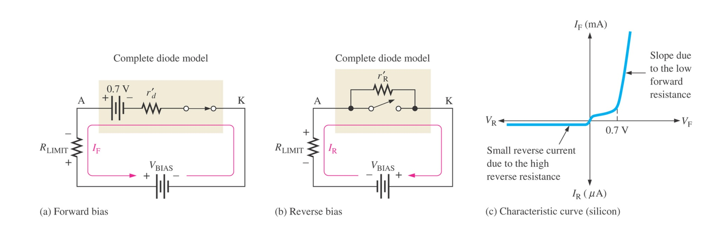
The complete model of a diode.
Thomas L. Floyd
Electronic Devices, Electron Flow Version, 5e
Copyright ©2005 by Pearson Education, Inc.
Upper Saddle River, New Jersey 07458
All rights reserved.

Slide 9
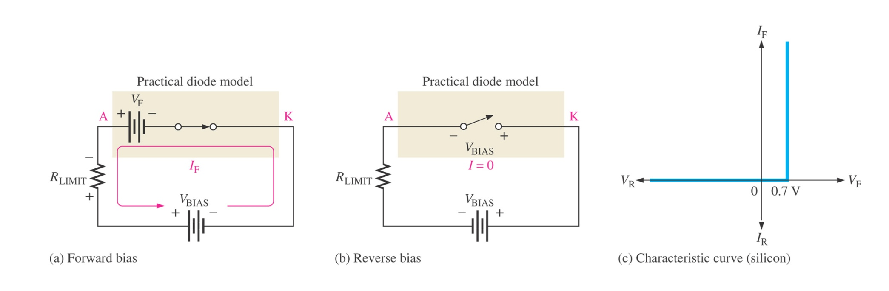
The practical model of a diode.
Thomas L. Floyd
Electronic Devices, Electron Flow Version, 5e
Copyright ©2005 by Pearson Education, Inc.
Upper Saddle River, New Jersey 07458
All rights reserved.

Slide 10
The Q Point
The operating point or Q point of the diode is the quiescent or no-signal condition. The Q point is obtained graphically and is really only needed when the applied voltage is very close to the diode’s barrier potential voltage. The example ³ below that is continued on the next slide, shows how the Q point is determined using the transconductance curve and the load line.
First the load line is found by substituting in different values of V_{φ} into the equation for I_{D} using the ideal diode with barrier potential model for the diode. With R_{S} at 1000 ohms the value of R_{F} wouldn’t have much impact on the results.
I_{D} = V_{A} – V _{φ}
R_{S}
Using V _{φ} values of 0 volts and 1.4 volts we obtain I_{D} values of 6 mA and 4.6 mA respectively. Next we will draw the line connecting these two points on the graph with the transconductance curve. This line is the load line.
R_{S} = 1000 Ω
I_{D}
+
V_{A}
= 6V
_
+
V_{φ}

Slide 11
The Q Point
The transconductance curve below is for a Silicon diode. The Q point in this example is located at 0.7 V and 5.3 mA.
I_{D} (mA)
12
10
8
Q Point: The intersection of the load line and the transconductance curve.
6
5.3
4.6
4
2
V_{D} (Volts)
0.2
0.4
0.6
0.8
1.0
1.2
1.4
0.7

Slide 12
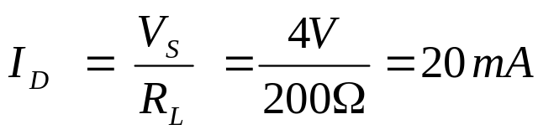
Diode DC Load Line
+ V_{T} - I_{D}
V_{s}=4V
R_{L}=200Ω
Using KVL: V_{S} = I_{D} R_{L} + V_{T}
(a) When V_{D} = 0 (y axis):
⇒ (0, 20 mA)
(b) When I_{D} = 0 (x axis):
V_{D} = V_{S} = 4 V ⇒ (4 V, 0)

Slide 13
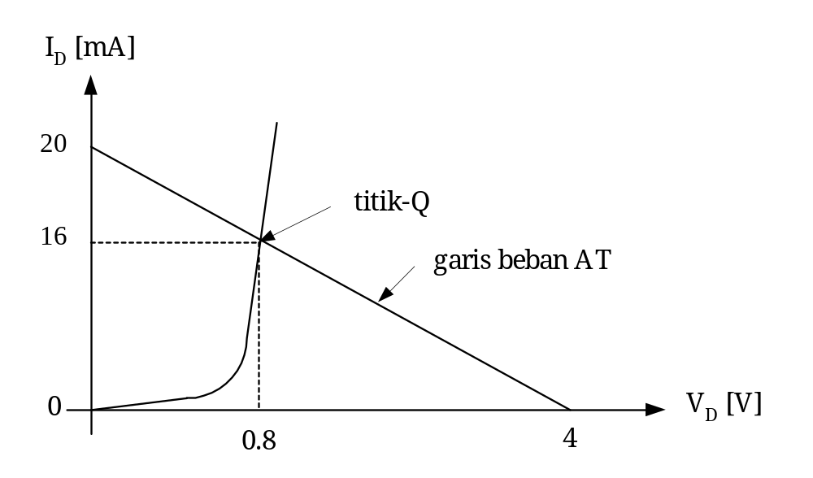
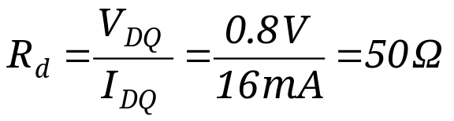
Diode DC Load Line
From the DC load line, the operating point (V_{DQ,,} I_{DQ}) is (0.8V, 16mA). The static resistance is calculated as:

Slide 14
The effect of R_{L} and V_{S} on DC load line
(i) R_{L} fixed, V_{S} changes
+ V_{T} -
I_{D}
KVL: V_{S} = I_{D} R_{L} + V_{T}
V_{S}
R_{L}
I_{D} [mA]
I_{DQ2} Q₂
slope= -1/R_{L}
I_{DQ1} Q₁
V_{DQ1} V_{DQ2}
V_{D} [V]
V_{S1}
V_{S2}

Slide 15
(ii) V_{S} fixed, R_{L} changes
The operating point (Q-point) changes and the slope of the DC load line also changes.
Example: Given V_{S} = 2V
If R_{L} = 5kΩ
⇒ I_{D} = 2V/5kΩ = 0.4 mA
If R_{L} = 1kΩ
⇒ I_{D} = 2V/1kΩ = 2 mA

Slide 16
V_{S} fixed, R_{L} changes
I_{D} [mA]
2 mA
Q₂
R_{L} = 1kΩ
R_{L} = 5kΩ
0.4 mA
Q₁
V_{S} = 2V
V_{D} [V]

